Slide 1
LABELLING RIGHT ANGLES TRIANGLES
hypotenuse
opposite
$$θ$$
adjacent

Slide 2
TASK: In each of these triangles label the opposite, adjacent, hypotenuse and the angle $θ$
$$θ$$
$$θ$$
$$θ$$
$$θ$$
opposite
opposite
$$θ$$
$$θ$$
opposite
adjacent
adjacent
adjacent

Slide 3
TASK: Use Pythagoras’ Theorem to complete this table of side ratios
Angle $\left(θ\right)$ rounded to 1d.p | $\frac{\text{opp}}{\text{hyp}}$ | $\frac{\text{adj}}{\text{hyp}}$ | $\frac{\text{opp}}{\text{adj}}$
$$8.8°$$ | $$\frac{13}{85}$$
$$10.4°$$ | $$\frac{11}{61}$$
$$11.4°$$ |  | $$\frac{99}{101}$$
$$12.7°$$ |  | $$\frac{40}{41}$$
$$14.3°$$ |  |  | $$\frac{16}{63}$$
$$16.3°$$ |  |  | $$\frac{7}{24}$$
$$18.9°$$ | $$\frac{12}{37}$$
$$22.6°$$ | $$\frac{5}{13}$$
$$25.1°$$ |  | $$\frac{77}{85}$$
$$26.0°$$ |  | $$\frac{80}{89}$$
$$28.1°$$ |  |  | $$\frac{8}{15}$$
$$30°$$ |  |  | $$\frac{\sqrt{3}}{3}$$
$$30.5°$$ | $$\frac{33}{65}$$
$$31.9°$$ | $$\frac{28}{53}$$
$$33.4°$$ |  | $$\frac{91}{109}$$
$$36.9°$$ |  | $$\frac{4}{5}$$
$$41.1°$$ |  |  | $$\frac{48}{55}$$
$$42.1°$$ |  |  | $$\frac{65}{72}$$
$$43.6°$$ | $$\frac{20}{29}$$
$$45°$$ | $$\frac{\sqrt{2}}{2}$$

Slide 4
TABLE OF SIDE RATIOS
Angle $\left(θ\right)$ rounded to 1d.p | $\frac{\text{opp}}{\text{hyp}}$ | $\frac{\text{adj}}{\text{hyp}}$ | $\frac{\text{opp}}{\text{adj}}$
$$8.8°$$ | $$\frac{13}{85}$$ | $$\frac{84}{85}$$ | $$\frac{13}{84}$$
$$10.4°$$ | $$\frac{11}{61}$$ | $$\frac{60}{61}$$ | $$\frac{11}{60}$$
$$11.4°$$ | $$\frac{20}{101}$$ | $$\frac{99}{101}$$ | $$\frac{20}{99}$$
$$12.7°$$ | $$\frac{9}{41}$$ | $$\frac{40}{41}$$ | $$\frac{9}{40}$$
$$14.3°$$ | $$\frac{16}{65}$$ | $$\frac{63}{65}$$ | $$\frac{16}{63}$$
$$16.3°$$ | $$\frac{7}{25}$$ | $$\frac{24}{25}$$ | $$\frac{7}{24}$$
$$18.9°$$ | $$\frac{12}{37}$$ | $$\frac{35}{37}$$ | $$\frac{12}{35}$$
$$22.6°$$ | $$\frac{5}{13}$$ | $$\frac{12}{13}$$ | $$\frac{5}{12}$$
$$25.1°$$ | $$\frac{36}{85}$$ | $$\frac{77}{85}$$ | $$\frac{36}{77}$$
$$26.0°$$ | $$\frac{39}{89}$$ | $$\frac{80}{89}$$ | $$\frac{39}{80}$$
$$28.1°$$ | $$\frac{8}{17}$$ | $$\frac{15}{17}$$ | $$\frac{8}{15}$$
$$30°$$ | $$\frac{1}{2}$$ | $$\frac{\sqrt{3}}{2}$$ | $$\frac{\sqrt{3}}{3}$$
$$30.5°$$ | $$\frac{33}{65}$$ | $$\frac{56}{65}$$ | $$\frac{33}{56}$$
$$31.9°$$ | $$\frac{28}{53}$$ | $$\frac{45}{53}$$ | $$\frac{28}{45}$$
$$33.4°$$ | $$\frac{60}{109}$$ | $$\frac{91}{109}$$ | $$\frac{60}{91}$$
$$36.9°$$ | $$\frac{3}{5}$$ | $$\frac{4}{5}$$ | $$\frac{3}{4}$$
$$41.1°$$ | $$\frac{48}{73}$$ | $$\frac{55}{73}$$ | $$\frac{48}{55}$$
$$42.1°$$ | $$\frac{65}{97}$$ | $$\frac{72}{97}$$ | $$\frac{65}{72}$$
$$43.6°$$ | $$\frac{20}{29}$$ | $$\frac{21}{29}$$ | $$\frac{20}{21}$$
$$45°$$ | $$\frac{\sqrt{2}}{2}$$ | $$\frac{\sqrt{2}}{2}$$ | $$1$$

Slide 5
TASK: Using the table of side ratios, find the lettered sides and angles.
1
2
970 mm
$x$ cm
$$8.8°$$
$$42.1°$$
42 cm
$x$ cm
3
4
3 cm
12.5 cm
$$12.7°$$
3.5 cm
$x$ cm
$$θ$$
5
6
$$θ$$
33 cm
$2\frac{1}{2}$cm
$$θ$$
$2\frac{5}{6}$cm
$6\frac{2}{3}$cm
7
8
14.6 cm
$$θ$$
5 cm
9.6 cm
$$θ$$
5 cm
9
10
5 cm
$x$ cm
1 cm
$x$ cm
$$25.1°$$
$$26.0°$$

Slide 6
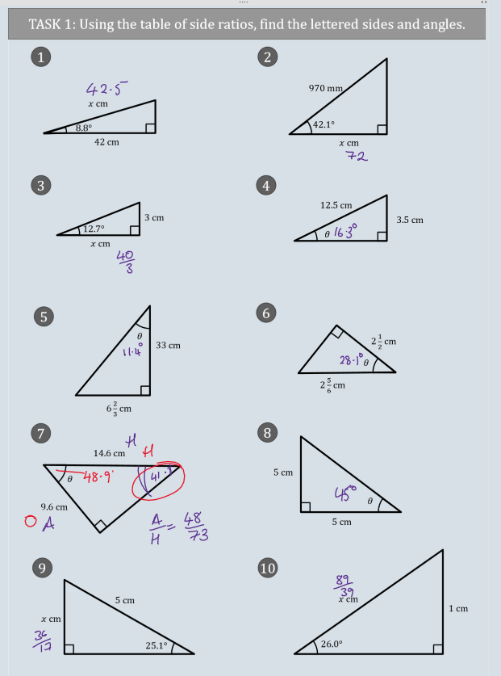

Slide 7
TRIGONOMETRIC RATIOS
hypotenuse
$$\sin{θ=\frac{\text{opposite}}{\text{hypotenuse}}}$$
opposite
$$θ$$
hypotenuse
$$\cos{θ=\frac{\text{adjacent}}{\text{hypotenuse}}}$$
$$θ$$
adjacent
$$\tan{θ=\frac{\text{opposite}}{\text{adjacent}}}$$
opposite
$$θ$$
adjacent

Slide 8
TASK
hypotenuse
$$\sin{35°=0.5736}$$
opposite
$$35°$$
20 cm
opposite
$$35°$$
hypotenuse
10 cm
$$35°$$

Slide 9
WORKED EXAMPLE – TRIGONOMETRY - FINDING LENGTHS
Veronica has answered this question correctly
Find the length of $x$
$x$ cm
17 cm
$$40°$$

Slide 10
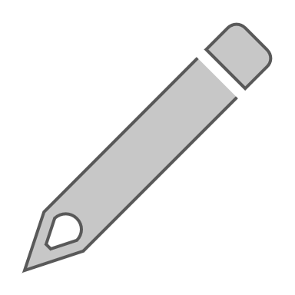
WORKED EXAMPLE – TRIGONOMETRY - FINDING LENGTHS
 | Study the solution carefully and answer these questions.
(1) | How does Veronica know to use the sine ratio?
(2) | Veronica’s friend types $17\left(\sin{40°}\right)$ into their calculator and gets the answer: $$10.9 \text{cm}$$ Explain how they can tell they have made a mistake.
(3) | What if the question was:
(a) | Which trigonometric ratio would you use?
(b) | What would your working look like?
10 cm
$$40°$$
$x$ cm

Slide 11
WORKED EXAMPLE – TRIGONOMETRY - FINDING ANGLES
Jordan has answered this question correctly
Find the length of $x$
3 cm
$$θ$$
8 cm

Slide 12
WORKED EXAMPLE – TRIGONOMETRY - FINDING ANGLES
 | Study the solution carefully and answer these questions.
(1) | How does Jordan know to use the tangent ratio?
(2) | Jordan’s friend has their calculator in the wrong mode. They get an answer of 0.359. Explain how they can tell they have a wrong answer.
(3) (a) | What mode should their calculator be in?
(b) | How can they check this?
(c) | What keys should they press to put it in the correct mode?
(4) | What if the question was
 | What would your first line of working look like?
10 cm
$$θ$$
7 cm

Slide 13
TASK
$\sin{θ}=\frac{5}{13}$
Label the triangle and find all the missing sides and angles
$$θ$$

